Slide 1
Cave Escape!
A game by Tyler Green and Steven Roberts

Slide 2
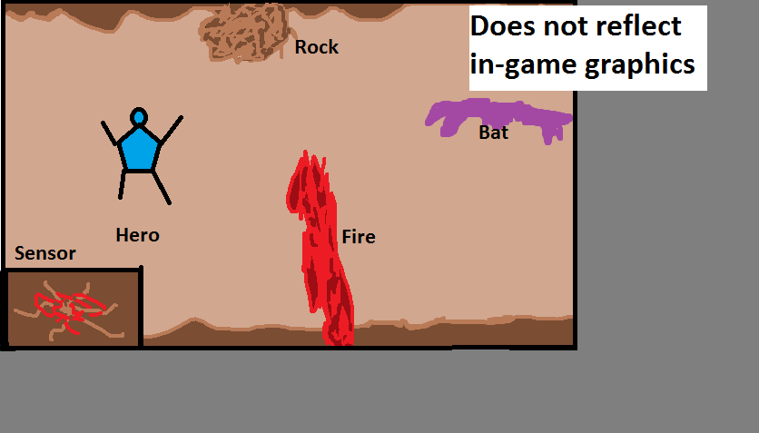
Game Overview
You are lost within a large, mysterious, and dangerous cavern! Can you dodge the many obstacles and escape?
-This is you.
-Not shown: jetpack, mining light, or actual appearance

Slide 3
How to Play
Hero at set X position relative to camera.
Press UP and DOWN to fly higher or lower
Press RIGHT or LEFT to speed up or slow down flight speed

Slide 4
Some Obstacles to Avoid
Bats! They fly in a line. Some Chase.
Rocks! Fall from top of screen. Pixel Perfect Collision.
Fire! Shoots up from bottom.
More obstacles at a time as you progress

Slide 5
Cameras
MAIN
HUD- (Life, etc.)
SENSOR

Slide 6
Lights
Warning: Darkness!
No Light
Hero’s Spotlight
Mining Light!
Fire!

Slide 7
Concept Art

